Slide 1

Tkinter 3
By shaily jain

Slide 2

Recap
Tkinter Framework
Widget , Advance widgets
Functions With Widgets
Events , Event handelers

Slide 3
What we are learning Today
Advance Functions of Tkinter
Object oriented programming with tkinter overview
Structure of Project
Topic selections
Draft our Final work

Slide 4

Think of your project TITLE

Slide 5



Advance tkinter
NOTEBOOK attribute:- The Notebook widget allows you to select pages of contents by clicking on tabs
To create a Notebook widget, you use the ttk.Notebook class as follows:
master: This is the parent widget of the notebook. Typically, it’s the main window.
**kw: This allows you to specify keyword arguments that control the appearance of the Notebook widget.

Slide 6
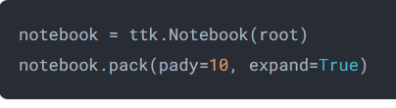

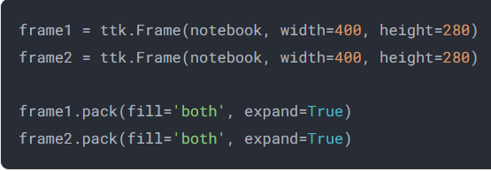
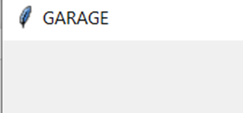
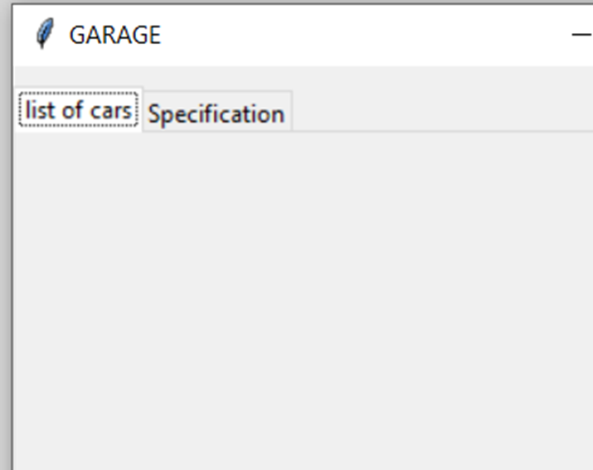
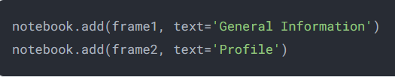
First, create a notebook widget whose parent is the root window:
Second, create two frames whose parent is the notebook:
Third, add these frames to the notebook by using the add() method:

Slide 7

import tkinter as tk
from tkinter import ttk
# root window
root = tk.Tk()
root.geometry('400x300')
root.title('GARAGE')
# create a notebook
notebook = ttk.Notebook(root)
notebook.pack(pady=10, expand=True)
# create frames
frame1 = ttk.Frame(notebook, width=400, height=280)
frame2 = ttk.Frame(notebook, width=400, height=280)
frame1.pack(fill='both', expand=True)
frame2.pack(fill='both', expand=True)
# add frames to notebook
notebook.add(frame1, text='list of cars')
notebook.add(frame2, text='Specification')
root.mainloop()

Slide 8
Tkinter Object-Oriented Window
Explore the fundamental concepts of Object-Oriented Programming (OOP) in the Python programming language. Discover how to create and utilize objects, classes, and inheritance to write modular, maintainable, and scalable code

Slide 9
Enabling High-DP1 IN WINDOWS 10
try:
from ctypes import windll
windll.shcore.SetProcessDpiAwareness(1)
except:
pass
To enable High DPI compatibility in Windows 10, you normally just have to add this: in your project folder structure create a py file give a name windows.
https://stackoverflow.com/questions/41315873/attempting-to-resolve-blurred-tkinter-text-scaling-on-windows-10-high-dpi-disp

Slide 10
Defining a Tkinter object-oriented window
import tkinter as tk
from tkinter import ttk
From windows import set_dpi_awareness
set_dpi_awareness()
Class Helloworld
Func _init_

Slide 11

Defining Classes and Objects
Class Definition
Instantiating Objects
In Python, a class is a blueprint for creating objects. It defines the properties and behaviors that the objects will have.
An object is an instance of a class. You can create multiple objects from the same class, each with its own unique state and behavior.
Attributes and Methods
Classes can have attributes (variables) and methods (functions) that define the object's characteristics and actions.

Slide 12

import tkinter as tk
from tkinter import ttk
class HelloWorld(tk.Tk):
def __init__(self):
super().__init__()
self.title("Hello World!")
ttk.Label(self, text="Hello, World!").pack()
root = HelloWorld()
root.mainloop()
Helloword is the name of our class
tk.TK IS ATTRIBUTE of class helloworld
Init is a method of our class and self is the attritubute of init method
In python 3 we can have a super class

Slide 13
__init__ Method
The __init__ method (also known as a constructor) is a special method in Python classes.
It is automatically called when an instance (object) of the class is created.
Its primary purpose is to initialize the object’s attributes (variables) and set up its initial state.
When you create a custom widget or GUI component using Tkinter, you define an __init__ method for that widget.
This method is responsible for configuring the widget’s appearance, behavior, and any other necessary setup.
For example, if you’re creating a custom button widget, the __init__ method would set the button’s label, size, and other properties.

Slide 14
The self Attribute:
In Python, self refers to the current instance of the class.
It acts as a reference to the object itself.
When you define methods (functions) within a class, you need to include self as the first parameter. This allows those methods to access and modify the object’s attributes.
By convention, the first parameter of any instance method in a class is named self. However, you can technically choose any name for it (though it’s best to stick with the convention).
Inside the class, you use self to refer to instance variables (attributes) and call other methods on the same object.
Outside the class (when interacting with the object), you don’t need to explicitly pass self as an argument; Python handles it automatically.

Slide 15
CONTAINER
In Tkinter, a container is a widget that serves as an invisible grouping element for other widgets. Its primary purpose is to organize and arrange other widgets within a graphical user interface (GUI).
Frame Widget
The most common container widget in Tkinter is the Frame.
A Frame acts as a rectangular area where you can place other widgets (such as buttons, labels, or entry fields).
It provides a way to group related widgets together both visually and at the coding level.
You can think of a Frame as a container box that holds other widgets.
When you create a Frame, it doesn’t display anything itself; its purpose is to organize its child widgets.

Slide 16

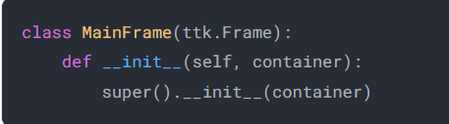
Creating a Class for a Frame
To inherit the ttk.Frame class, you use the following syntax:
Since a Frame needs a container, you need to add an argument to its __init__() method and call the __init__() method of the ttk.Frame class like this:

Slide 17
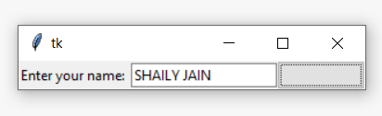

import tkinter as tk
from tkinter import ttk
class UserInputFrame(ttk.Frame):
def __init__(self, container):
super().__init__(container)
self.user_input = tk.StringVar()
label = ttk.Label(self, text="Enter your name: ")
entry = ttk.Entry(self)
button = ttk.Button(self, command=self.greet)
label.pack(side="left")
entry.pack(side="left")
button.pack(side="left")
def greet(self):
print(f"Hello, {self.user_input.get()}!")
root = tk.Tk()
frame = UserInputFrame(root)
frame.pack()
root.mainloop()
This defines a custom frame class named UserInputFrame, which inherits from the ttk.Frame class.
This line calls the constructor of the superclass (ttk.Frame) to initialize the frame within the specified container.
This creates a StringVar instance to store the value entered by the user in the entry field.
This creates an instance of the UserInputFrame class, passing the main window as the container.

Slide 18
import tkinter as tk
from tkinter import ttk
class HelloWorld(tk.Tk):
def __init__(self):
super().__init__()
self.title("Hello World!")
frame = UserInputFrame(self)
frame.pack()
class UserInputFrame(ttk.Frame):
def __init__(self, container):
super().__init__(container)
self.user_input = tk.StringVar()
label = ttk.Label(self, text="Enter your name: ")
entry = ttk.Entry(self)
button = ttk.Button(self, command=self.greet)
label.pack(side="left")
entry.pack(side="left")
button.pack(side="left")
def greet(self):
print(f"Hello, {self.user_input.get()}!")
root = HelloWorld()
root.mainloop()

Slide 19
Modular STRUCTURE of Tkinter
We'll create a basic HR Management System with functionalities like adding employees, displaying employee information, and connecting to a SQL database.
Let's start by creating the main file main.py and several modules for different aspects of the HR Management System:
main.py: The main file to run the application.
hr_app.py: The main Tkinter GUI application.
database.py: Module to handle the SQL database operations.
employee.py: Module to define the Employee class and related functionalities.
I have created this structure in Example HR system jupitor fle

Slide 20
Main file
from hr_app import HRApp
if __name__ == "__main__":
app = HRApp()
app.run()

Slide 21
2. hr_app.py: The main Tkinter GUI application
import tkinter as tk
from tkinter import ttk, messagebox
from employee import Employee
from database import Database
class HRApp:
def __init__(self):
self.root = tk.Tk()
self.root.title("HR Management System")
self.database = Database()
self.initialize_ui()

Slide 22
3. database.py: Module to handle the SQL database operations.
import pyodbc
class Database:
def __init__(self):
self.connection = pyodbc.connect('Driver={SQL Server};'
'Server=Your_Server_Name;'
'Database=Your_Database_Name;'
'Trusted_Connection=yes;')
def add_employee(self, employee):
cursor = self.connection.cursor()
cursor.execute("INSERT INTO employees (name, position, salary) VALUES (?, ?, ?)",
(employee.name, employee.position, employee.salary))
self.connection.commit()
def get_employee_info(self, employee_id):
cursor = self.connection.cursor()
cursor.execute("SELECT * FROM employees WHERE id=?", (employee_id,))
employee_data = cursor.fetchone()
if employee_data:
return Employee(*employee_data)
# Other database operations
pip install pyodbc

Slide 23
4.employee.py: Module to define the Employee class and related functionalities.
class Employee:
def __init__(self, name, position, salary):
self.name = name
self.position = position
self.salary = salary
# Getter and setter methods for Employee attributes

Slide 24

Creating Table structure for data base
CREATE TABLE employees (
id INT PRIMARY KEY IDENTITY(1,1)
name NVARCHAR(100),
position NVARCHAR(100),
salary FLOAT
);
CREATE TABLE employee_department (
employee_id INT,
department_id INT,
PRIMARY KEY (employee_id, department_id),
FOREIGN KEY (employee_id) REFERENCES employees(id),
FOREIGN KEY (department_id) REFERENCES departments(id)
);
CREATE TABLE departments (
id INT PRIMARY KEY IDENTITY(1,1),
name NVARCHAR(100)
);
CREATE TABLE employee_project (
employee_id INT,
project_id INT,
PRIMARY KEY (employee_id, project_id),
FOREIGN KEY (employee_id) REFERENCES employees(id),
FOREIGN KEY (project_id) REFERENCES projects(id)
);
CREATE TABLE projects (
id INT PRIMARY KEY IDENTITY(1,1),
name NVARCHAR(100),
details NVARCHAR(MAX)
);

Slide 25
Let’s look at quiz and example
https://docs.python.org/3/library/tk.html
https://www.pythontutorial.net/python-oop/

